Slide 1




EXCELSSIOR EDUCATION SOCIETY’S K. C. COLLEGE OF ENGINEERING AND MANAGEMENT STUDIES AND RESEARCH (Affiliated to the University of Mumbai) Mith Bunder Road, Near Hume Pipe, Kopari, Thane(E)-400603
Department Of Information Technology
Academic Year 2023-24(Odd Semester)

Slide 2
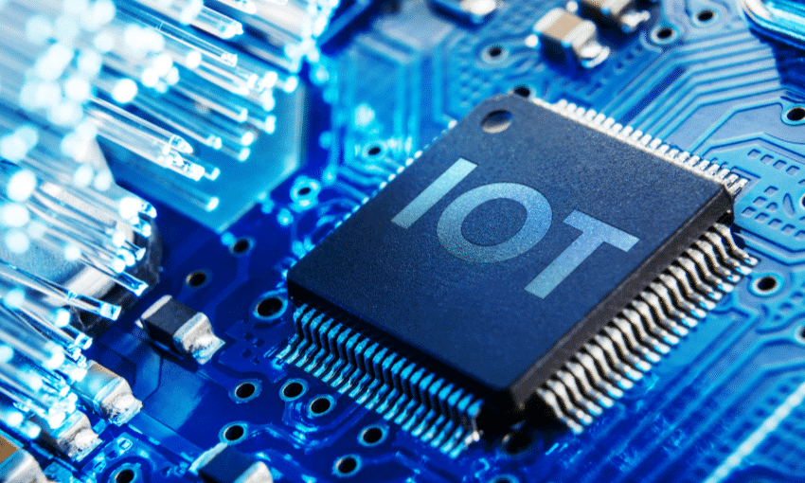
Topic : Sign Language Vocalizer
Group members:-
1)Kushal Amin- 01
2)Kaustubh Ardekar - 02
3)Tanishk Gupta-18
Guide : Prof. Shubhangi Verulkar

Slide 3
Index
Introduction to Topic
Need of Project
Problem Statement
Scope
BLOCK Diagram and Flow chart
System Design
Requirement Hardware and Software

Slide 4
INTRODUCTION
Sign language vocalizer is a device that translates sign language gestures into spoken words. It is a valuable tool for people who are deaf or hard of hearing, as it allows them to communicate more effectively with others.
IoT-based sign language vocalizers have the potential to revolutionize the way that people who are deaf or hard of hearing communicate with the world around them.

Slide 5
NEED OF PROJECT
Sign language vocalizers using IoT have the potential to improve the lives of people with hearing impairments by enabling them to communicate more effectively with the world around them.
Communication barriers: Sign language vocalizers can help to break down communication barriers between people who use sign language and those who do not.
Education: Sign language vocalizers can help to improve the educational experience of deaf and hard of hearing students.
Employment: Sign language vocalizers can help people with hearing impairments to gain and maintain employment.

Slide 6
PROBLEM STATEMENT
*People who are deaf or hard of hearing often face significant communication barriers. They may have difficulty communicating with people who do not know sign language, and they may also have difficulty communicating in noisy environments. This can lead to social isolation, employment discrimination, and other challenges.Traditional sign language vocalizers can help to address these communication barriers, but they have a number of limitations.
*They can be more affordable, accurate, and easy to use than traditional sign language vocalizers. Additionally, they can be integrated with other IoT devices to create more sophisticated and powerful applications.However, there are still a number of challenges that need to be addressed before IoT-based sign language vocalizers can be widely adopted.
*One challenge is developing accurate and reliable machine learning algorithms for sign language recognition. Another challenge is developing IoT-based sign language vocalizers that are affordable and easy to use.
Despite these challenges, IoT-based sign language vocalizers have the potential to revolutionize the way that people who are deaf or hard of hearing communicate with the world around them.

Slide 7
SCOPE
The scope of a sign language vocalizer using IoT is vast and has the potential to revolutionize the way deaf and hard of hearing people communicate with the hearing world.
Education: Sign language vocalizers could be used in classrooms to help deaf and hard of hearing students learn alongside their hearing peers. This would allow them to fully participate in class discussions and activities, and to receive feedback from their teachers.
Employment: Sign language vocalizers could be used in workplaces to help deaf and hard of hearing employees communicate with their colleagues and customers. This would allow them to participate fully in meetings, presentations, and other work-related activities.
Social interaction: Sign language vocalizers could help deaf and hard of hearing people to interact with their friends, family, and other members of the community. This would allow them to participate in social events, conversations, and other activities.

Slide 8
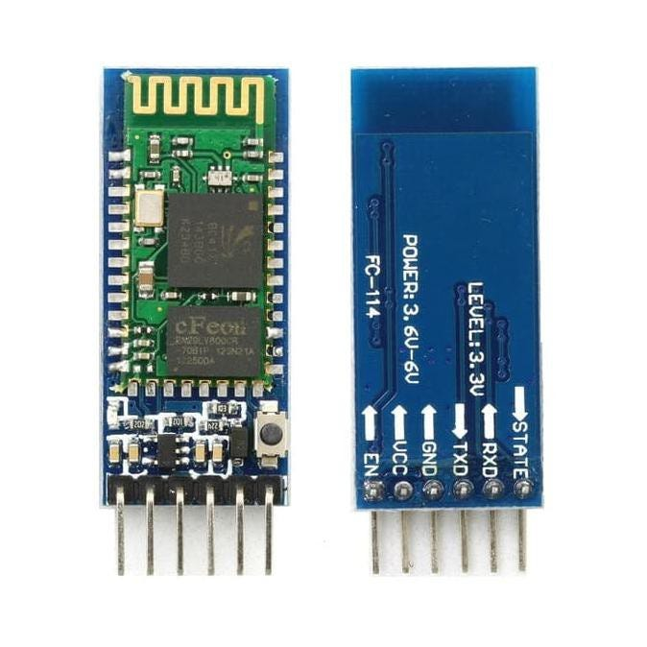
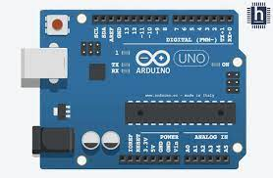
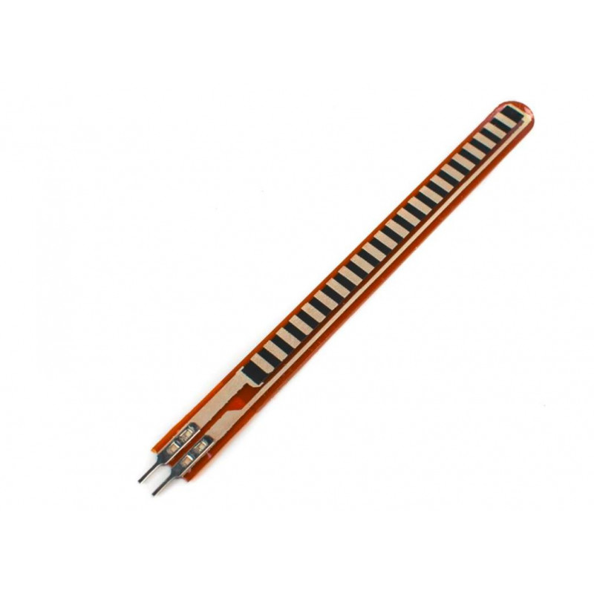
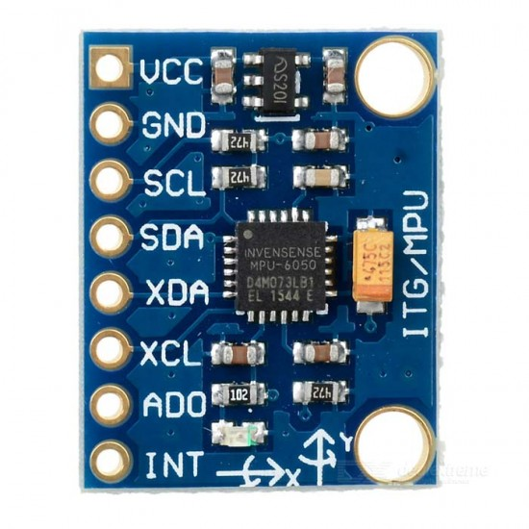
Hardware and Software Requirements
Hardware Requirement –
Flex Sensors
MPU 6050
HC-05 Bluetooth module
Arduino Uno board
Software Requirement –
Arduino IDE
Android Bluetooth app (Text-speech)

Slide 9
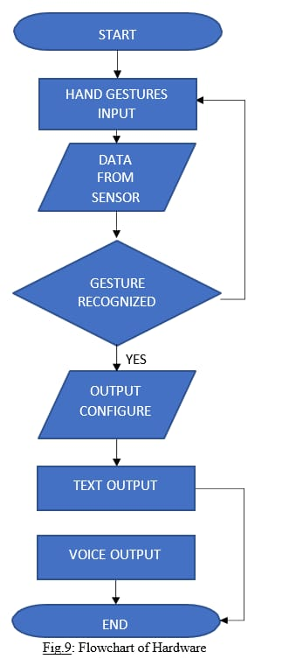
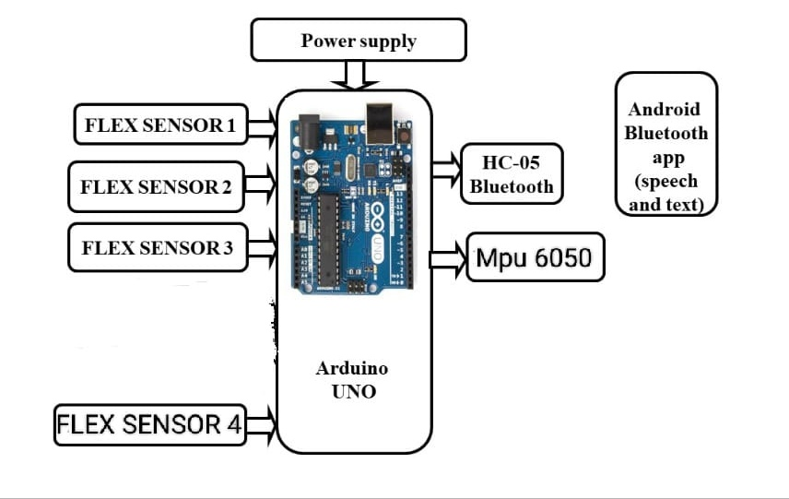
Block Diagram & Flow chart

Slide 10
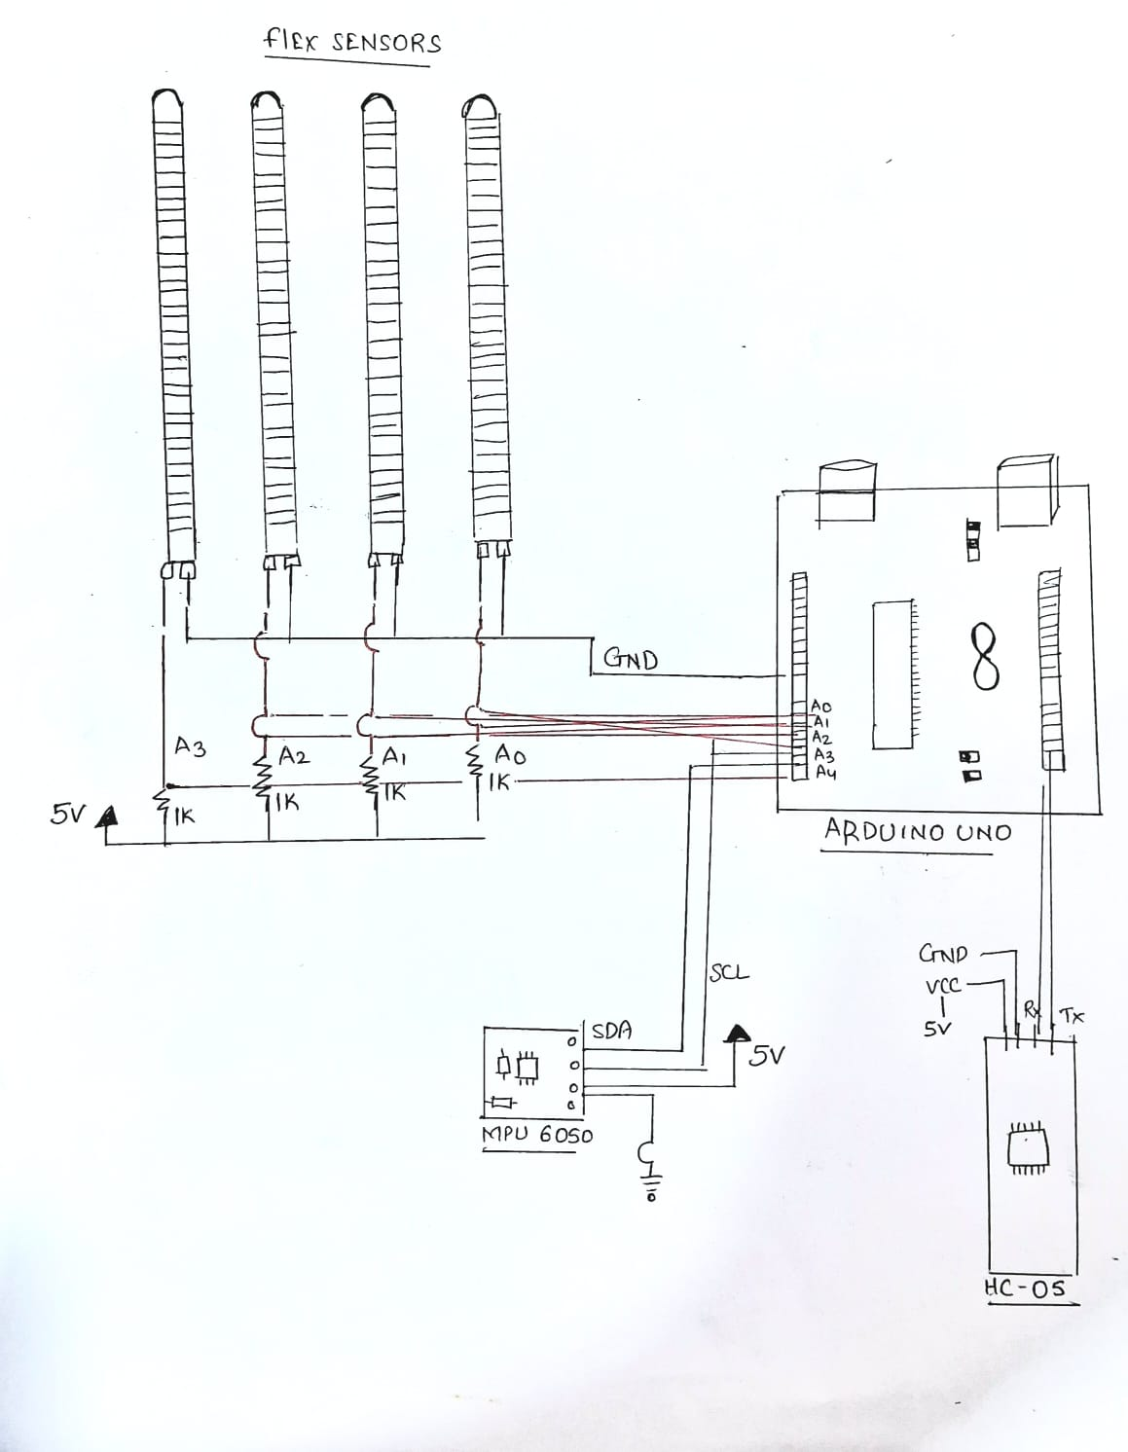
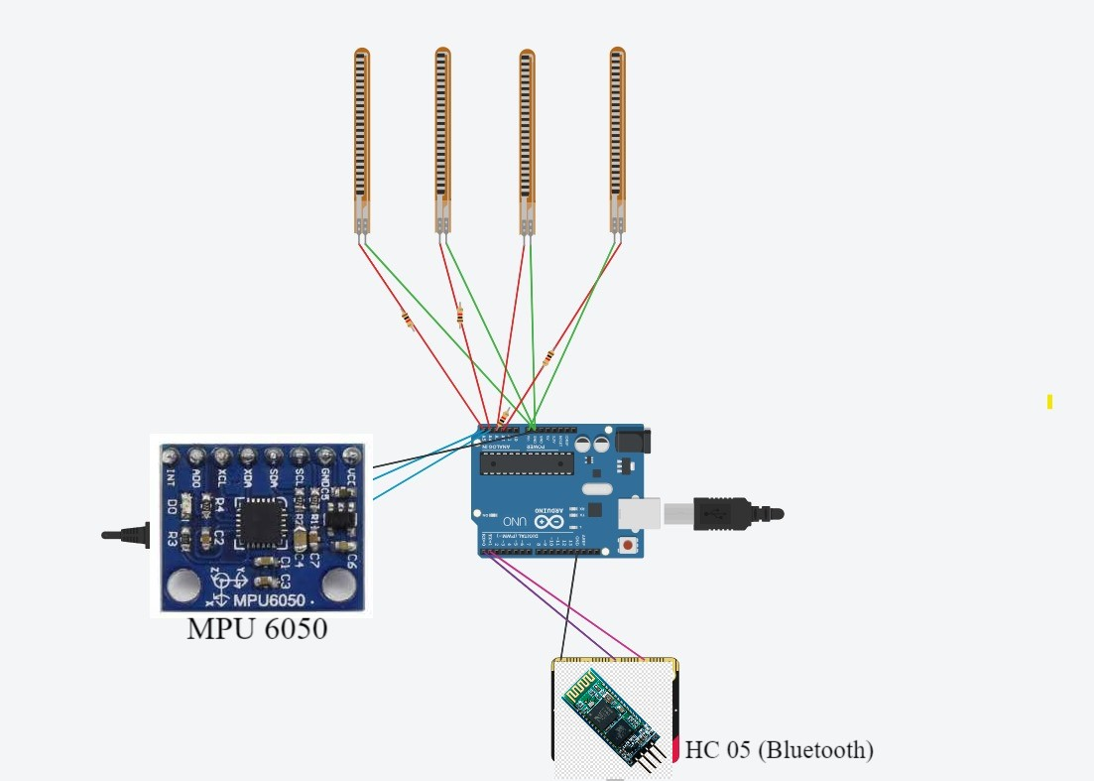
CIRCUIT Diagram

Slide 11
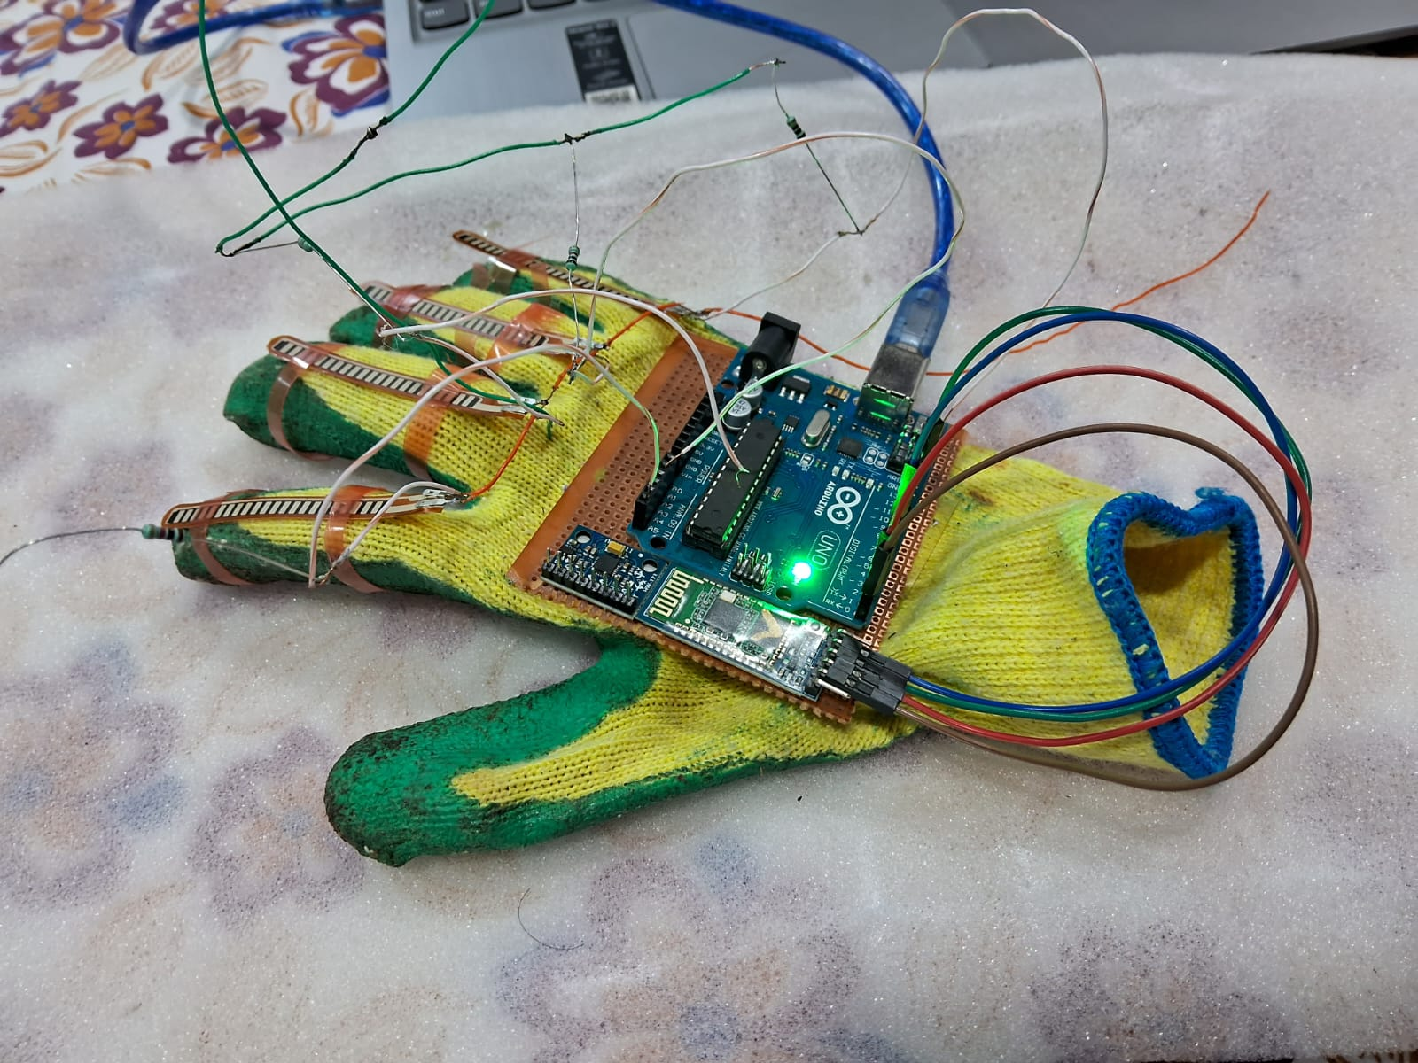
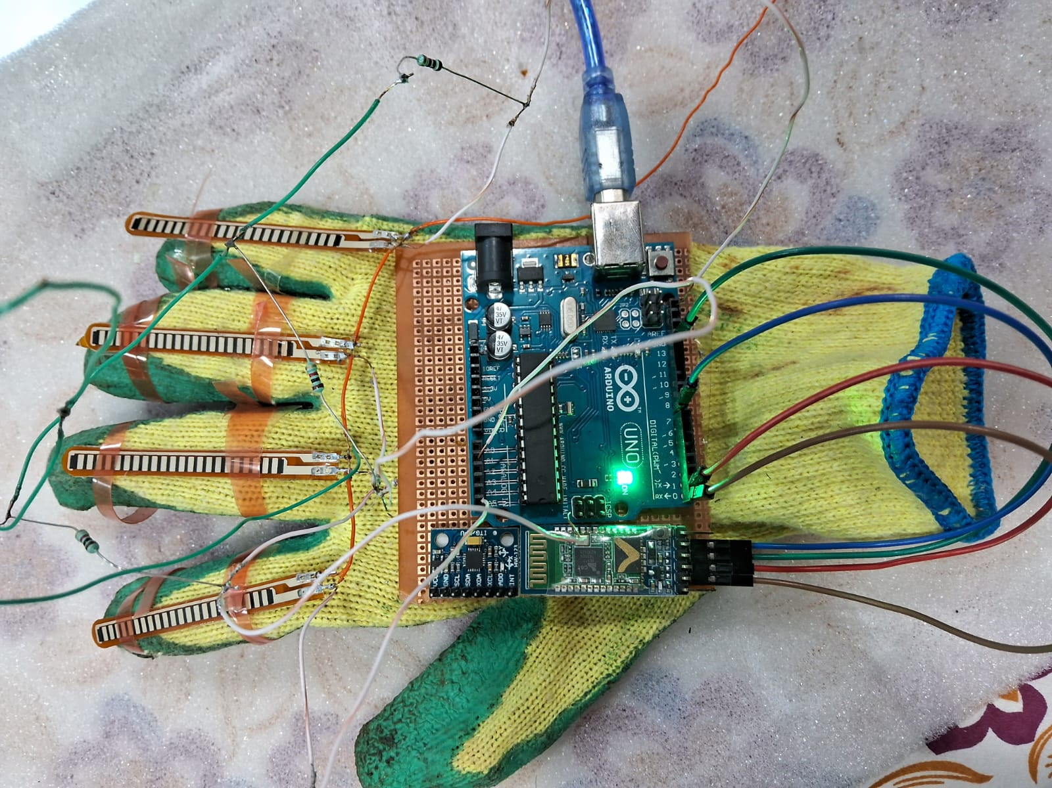
SYSTEM DESIGN

Slide 12
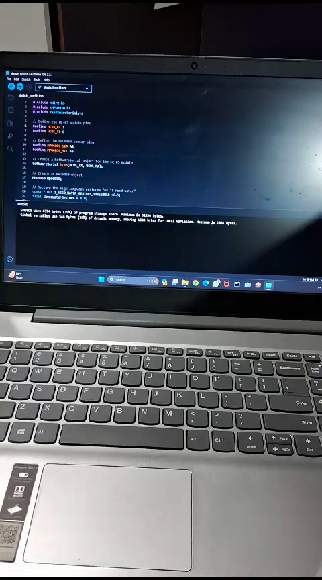

Slide 13
Conclusion
Sign language vocalizers are a valuable tool for people who are deaf, hard of hearing, or learning sign language. They can help to improve communication and accessibility for people with disabilities. In the future, sign language vocalizers are expected to become more accurate, efficient, and affordable. They may also be integrated with other technologies to create new and innovative communication experiences.

Slide 14
Reference
[1] Kunal Kadam, Rucha Ganu, Ankita Bhosekar, Prof. S. D. Joshi , “American Sign Language Interpreter”, Proceedings of the 2023 IEEE Fourth International Conference on Technology for Education.
[2] Srinivas Gutta, Jeffrey Huang, Ibrahim F. Imam,and Harry Wechsler,“Face and Hand GestureRecognition Using Hybrid Classifiers”, ISBN: 0-8186-7713-9/96, pp.164-16
[3] Hope M Hurlbut, "A Lexicostatistic Servey of the Signed Languages in Nepal," SIL Electronic Survey Reports, p. 23, June 2022.
[4] R.L.R. Lokesh Babu , S. Gagana Priyanka , P.Pooja Pravallika , Ch. Prathyusha – “Gesture Vocalizer”.
[5] Prerana K.C, Nishu Mahato, and Bishruti Satyal, "Hand Gesture Recognition using KINECT," Nepal Engineering College, Baktapur, Bachelor Thesis P3-I.0-14-4, 2019.

Slide 15


